Slide 1
Project : Cash forecasting Operations And Reporting In Oracle ERP .
Objective to set up a basic cash forecasting model using historical cash inflows and outflows , use forecasting tools to estimate future cash balances

Slide 2
Meet our Team
Mustafa Mohamed Mustafa
Mohamed Ahmed

Slide 3
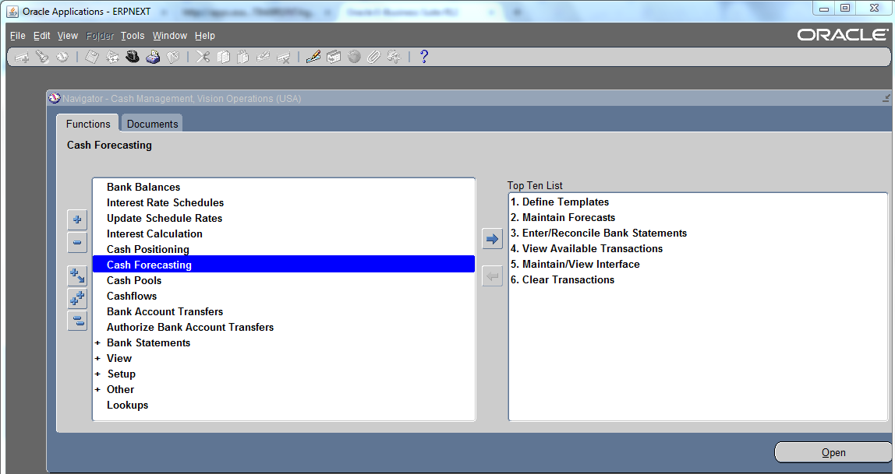
1- Switch responsibility: - Cash Management, Vision Operations (USA) - cash forecasting

Slide 4
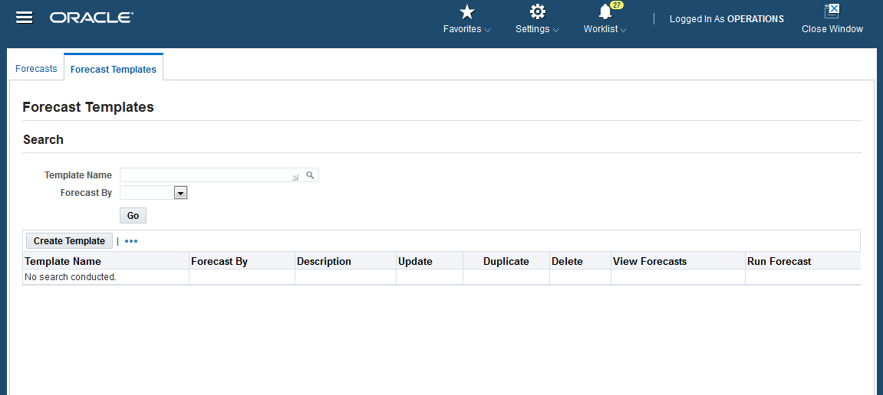
2- click button create template forecasting
.

Slide 5
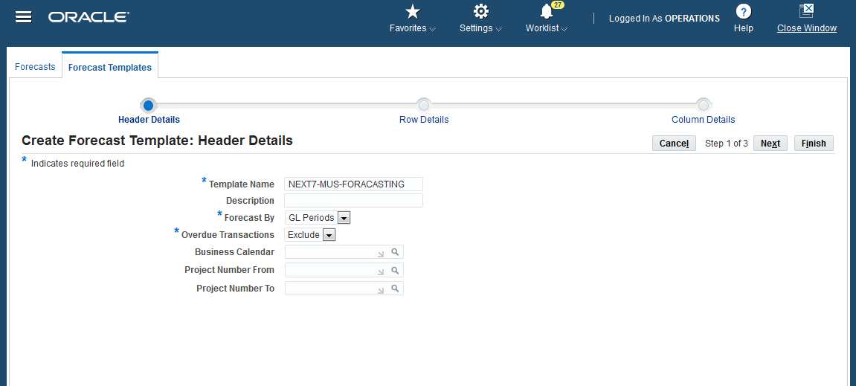
3- Enter the ‘Template Name’, ‘Forecast By’’ and ‘Overdue Transactions ’then Click on Next

Slide 6
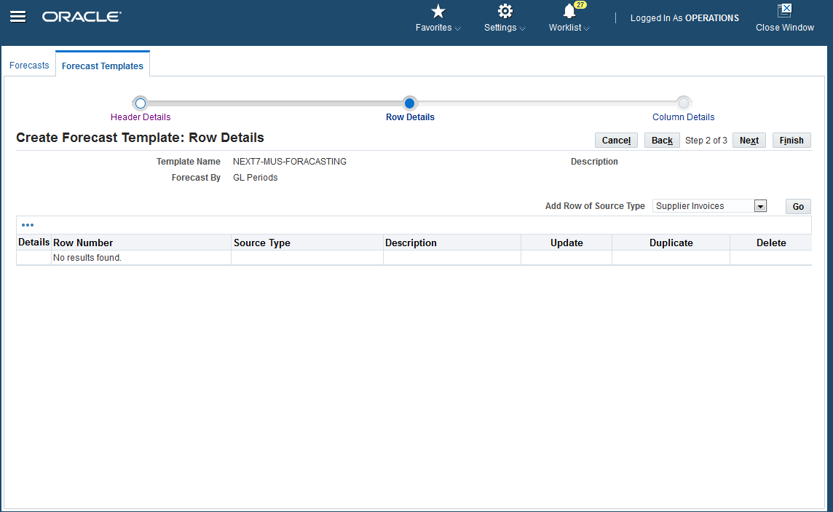
4- Select ‘Add Row of Source Type’ ‘supplier invoices ’ then click on GO

Slide 7
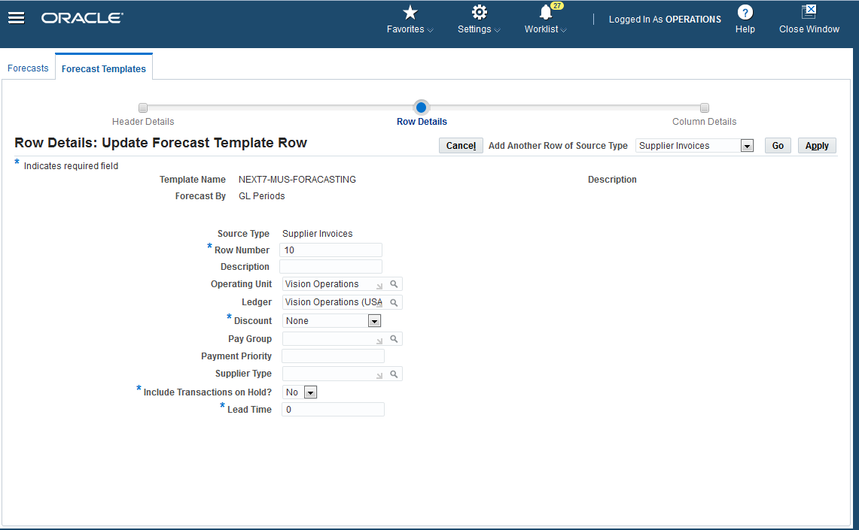
5- Enter the Row number as 10, Description, Operating Unit as Vision Operations, Ledger as Vision Operations (USA), Enter the other required fields then Click on Apply button.

Slide 8
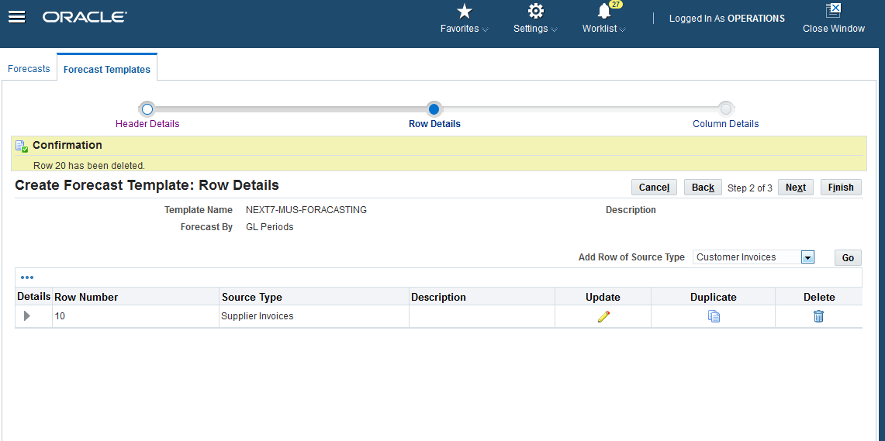
6- Select ‘Add Row of Source Type’ ‘Customer Invoices’ then click on GO

Slide 9
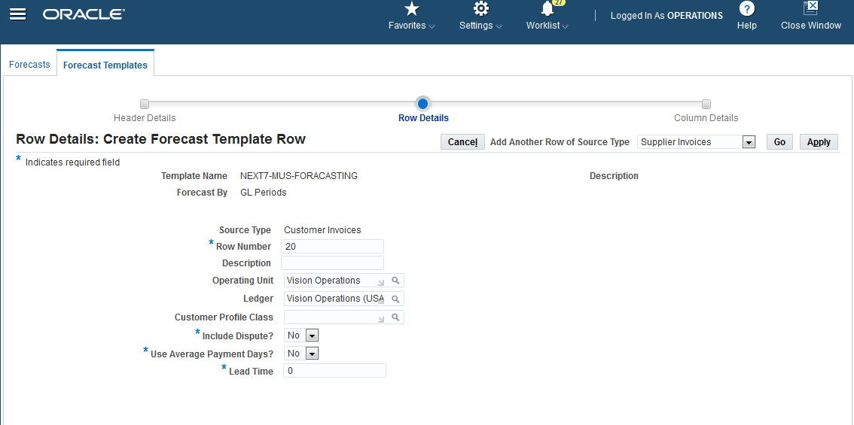
7- Enter the Row number as 20, Description, Operating Unit as Vision Operations, Ledger as Vision Operations (USA), Enter the other required fields then Click on Apply button

Slide 10
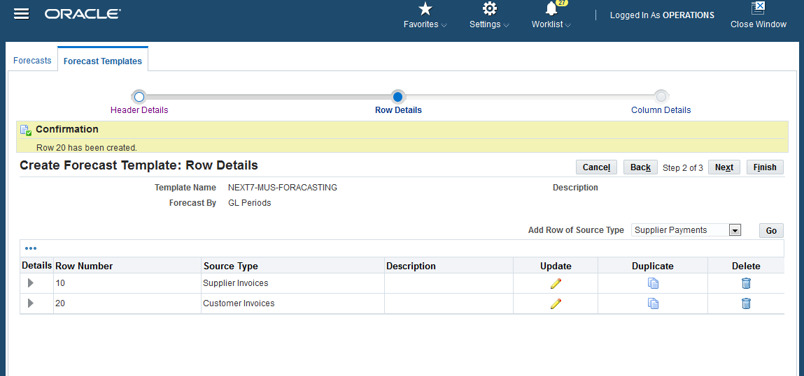
8- Select ‘Add Row of Source Type’ ‘Supplier Payment’ then click on GO

Slide 11
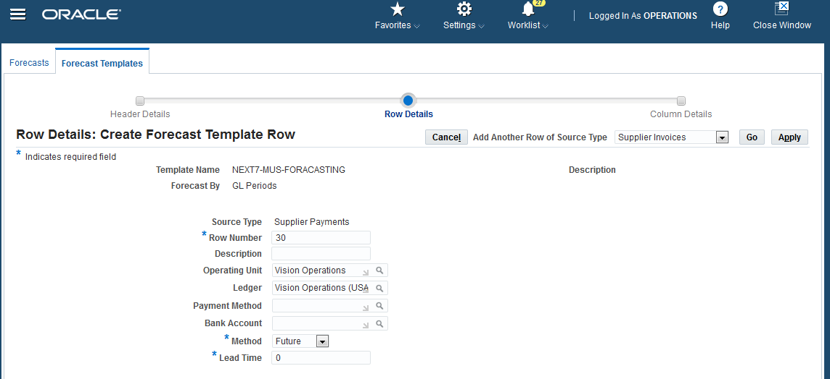
9- Enter the Row number as 30, Description, Operating Unit as Vision Operations, Ledger as Vision Operations (USA), Enter the other required fields then Click on Apply button

Slide 12
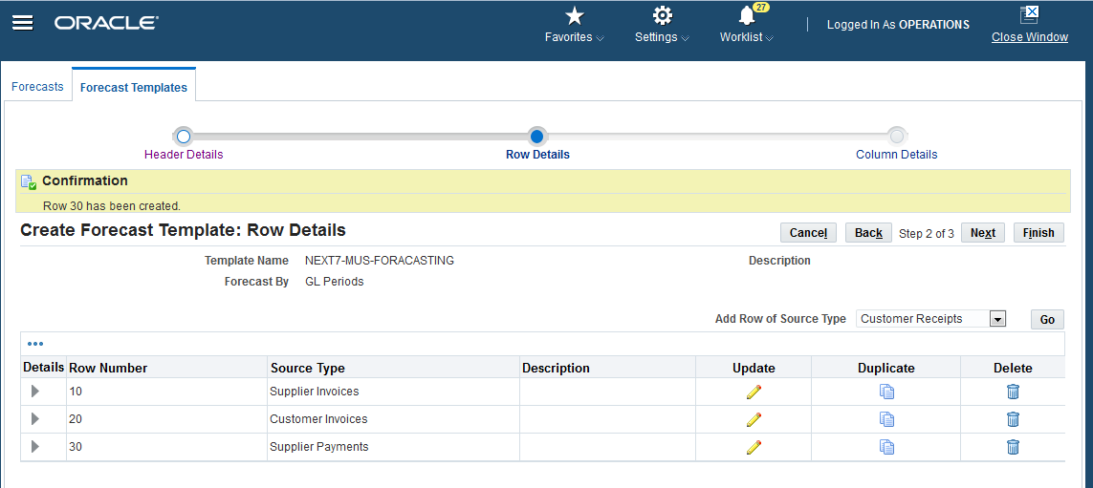
10- Select ‘Add Row of Source Type’ ‘Customer receipts’ then click on GO

Slide 13
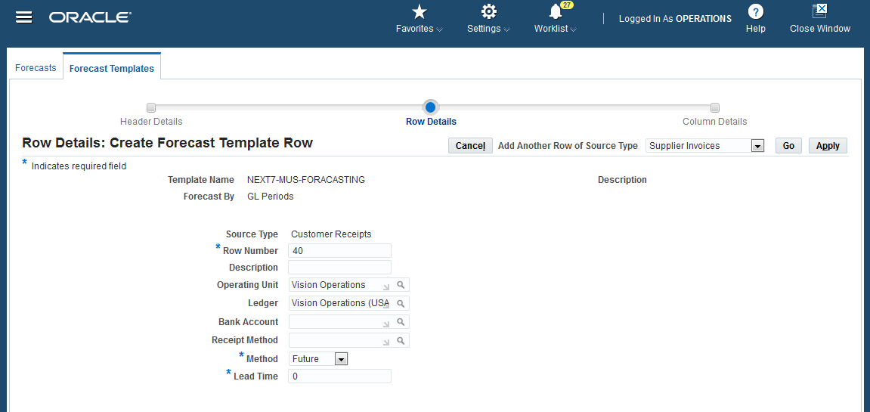
11- Enter the Row number as 40, Description, Operating Unit as Vision Operations, Ledger as Vision Operations (USA), Enter the other required fields then Click on Apply button

Slide 14
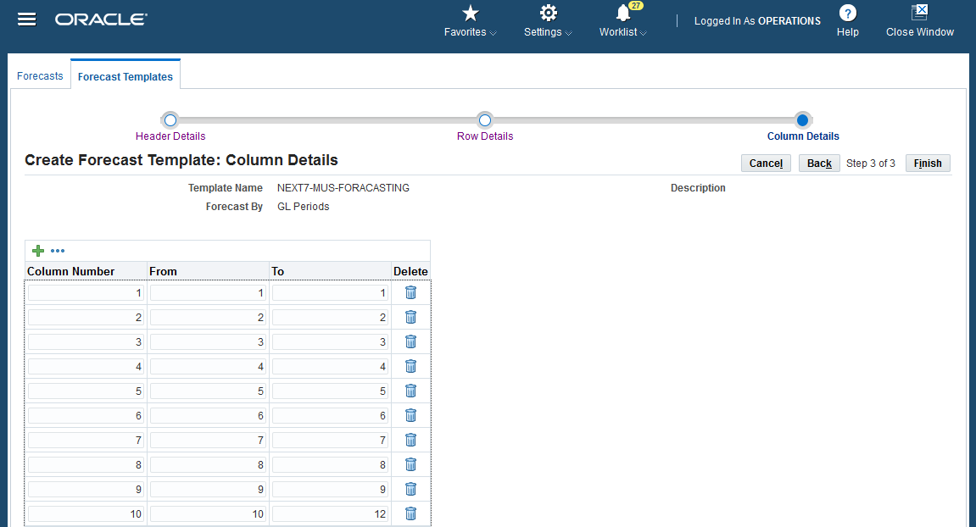
12- Click on Next - Give the Column Numbers from 1 to 12 - Click on Finish

Slide 15
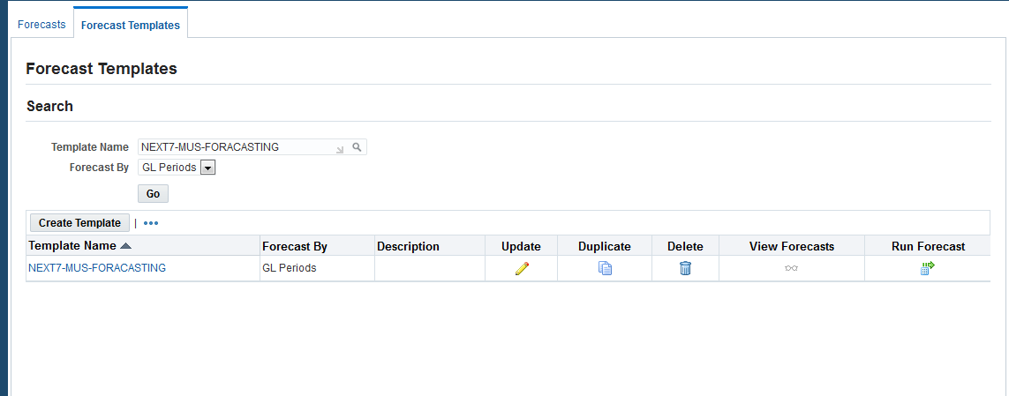
13- Click on Run forecast

Slide 16
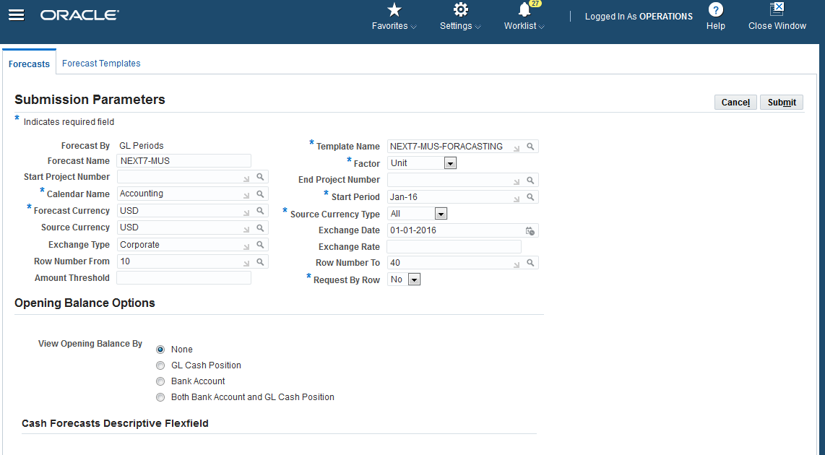
14- Enter the other required fields Then click on Submit

Slide 17
15- Enter the other required fields

Slide 18
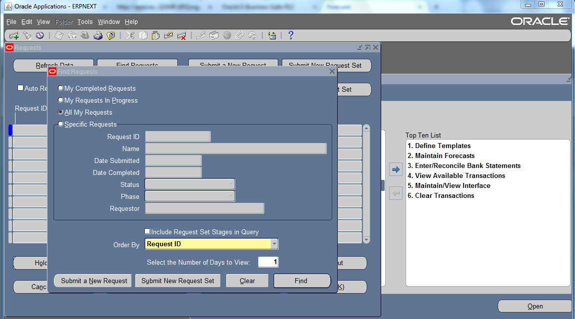
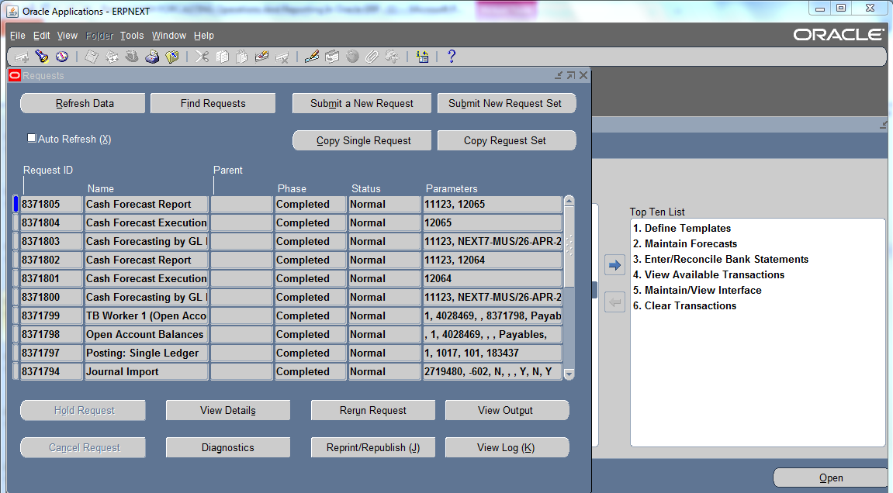
16- Click on view- Request- Find

Slide 19
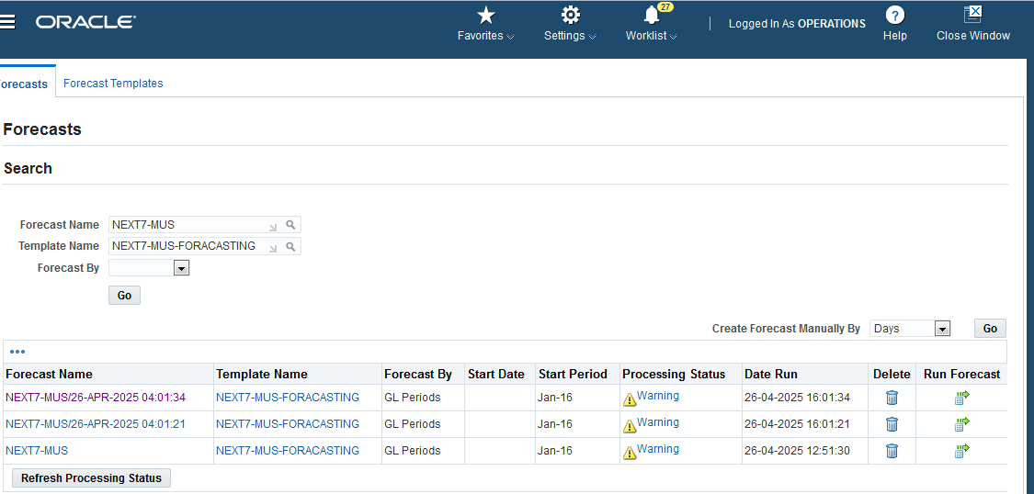

Slide 20
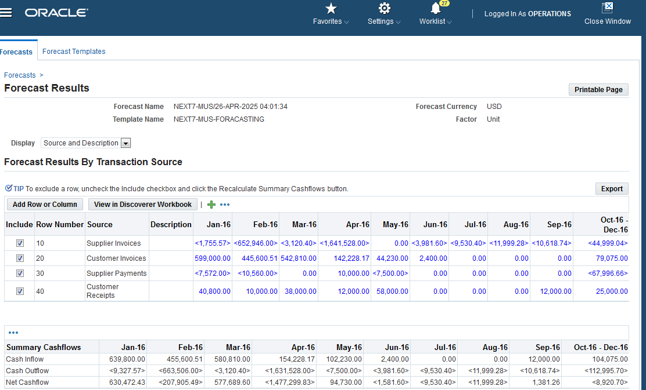

Slide 21
Thank you for reviewing this presentation!

